Slide 1
Temperature Data
Rafael da Rocha Ribeiro
Inatel – IDP
Technical Evaluation II

Slide 2
Motivation
Temperature is a major concern in agronomy;
Be able to store and manage temperature data from historical database;
Be able to store and manage temperature from any day with specific payload;
Be able to provide data to IA for analyze and prediction

Slide 3
API Flow of work
Access through REST
Stormglass API
My API
Validation
MySQL DB

Slide 4
Allowed Requests
This API have three controllers;
CityRegister Controller;
Stormglass Controller;
TemperatureData Controller;

Slide 5
CityRegister Controller
Two allowed Http Request:
GET – list all registered city in DB;
POST – Register a new city in DB with city name, latitude and longitudedata;

Slide 6
Stormglass Controller
Responsible to handle the request to the API and do the conversions required
to store the data in DB;
Allowed Http Request:
POST – Retrieve the data from Stormglass and store the data in DB;
This is where the historical database came from;

Slide 7
TemperatureData Controller
The main controller for this API, handle all the information required by the user;
Allowed Http Request:
GET – List all registers in DB;
GET – With the parameter city name, list all temperature by the city name;

Slide 8
TemperatureData Controller
GET – Return the highest temperature by the given city name;
GET – Return the lowest temperature by the given city name;
POST – Register a temperature by city name, date and temperature, validates if the city is registered in DB;
DELETE – Delete a register by the city name

Slide 9
Documentation
Swagger documentation with Springfox;

Slide 10
Tests
Unit Tests:
Test done in the service layer:

Slide 11
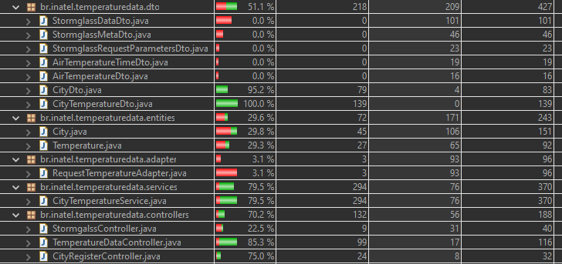
Tests
Functional Tests:
Tests done using WebClient in controller and service:

Slide 12
Points to improve
Use of Lombok;
OpenAPI documentation;
Containerization;
Use of mappers instead of DTO;
Security and user’s register and control;
Because of the lack of experience and time, all those points was left behind;

Slide 13
Q&A Time!

